Slide 1


Slide 2

Dmytro Shcherbatiuk
I'm software engineer with years of experience in Java.
I love to work on challenging tasks, distributed systems, prefer active sports like, tennis and snowboarding and like programming on an Elixir lang.
I believe that success comes when you do what you love!

Slide 3
Content
Domain-specific language
Fluent Interface
Method chaining pattern
Add rules for chaining pattern
Frameworks to create Fluent Interface
Questions
Topics for further events

Slide 4

Domain-specific language

Slide 5
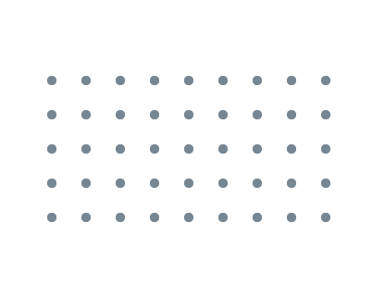
What is domain specific language (DSL)?
DSL is a computer language that's targeted to a particular kind of problem, rather than a general purpose language that's aimed at any kind of software problem.
DSL provides declarative style of programming (declarative programming consists of instructing a program on what needs to be done) instead of imperative one (telling it how to do it).
There are two kinds of textual DSLs: external and internal. An external DSL is a domain-specific language represented in a separate language to the main programming language it’s working with. An internal DSL is a domain-specific language represented within the syntax of a general-purpose language. It’s a stylized use of that language for a domain-specific purpose.
DSL can be presented in different forms: - Fluent Interface (Will be discussed today) - xml, yml, … - (A)BNF grammar

Slide 6
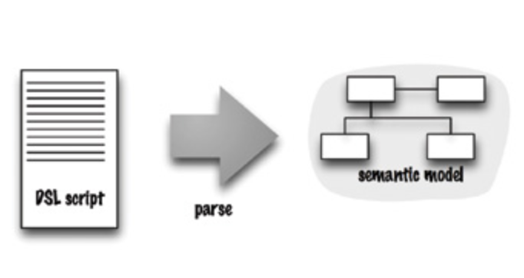
Architecture of DSL Processing

Slide 7
Examples of DSLs
Html
AWK (designed for text processing and typically used as a data extraction and reporting tool.) BEGIN { print "Hello, world!" }
Erlang OTP (The Erlang Open Telecom Platform was originally designed for use inside Ericsson as a domain-specific language)
Gherkin (designed to define test cases to check the behavior of software, without specifying how that behavior is implemented) Scenario: Eric wants to withdraw money from his bank account at an ATM Given Eric has a valid Credit or Debit card And his account balance is $100 When he inserts his card And withdraws $45 Then the ATM returns $45 And his account balance is $55
Gradle
Google Truth (Fluent assertions for Java and Android)
Java Stream
Apache Camel

Slide 8
Advantages and disadvantages of DSL
Advantages - DSL provides declarative approach. - DSL is more readable and fluency.
Disadvantages - Engeeneers doesn’t want to learn custom DSLs.

Slide 9
Fluent Interface

Slide 10
What is Fluent Interface
DSL provides fluency of writing code.
Fluent interface was a term coined by Eric Evans (author of DDD) and Martin Fowler to describe more language-like APIs. It’s a synonym for an internal DSL.
Fluent Interface is like a principle (there is on the same layer with SOLID principles)
The goal of Fluent Interface is to increase code legibility (get rid of imperative programming in favor of declarative programming).

Slide 11
Implementations of Fluent Interface
Method chaining pattern (Will be discussed today). Function sequence pattern.
Nested function pattern.

Slide 12
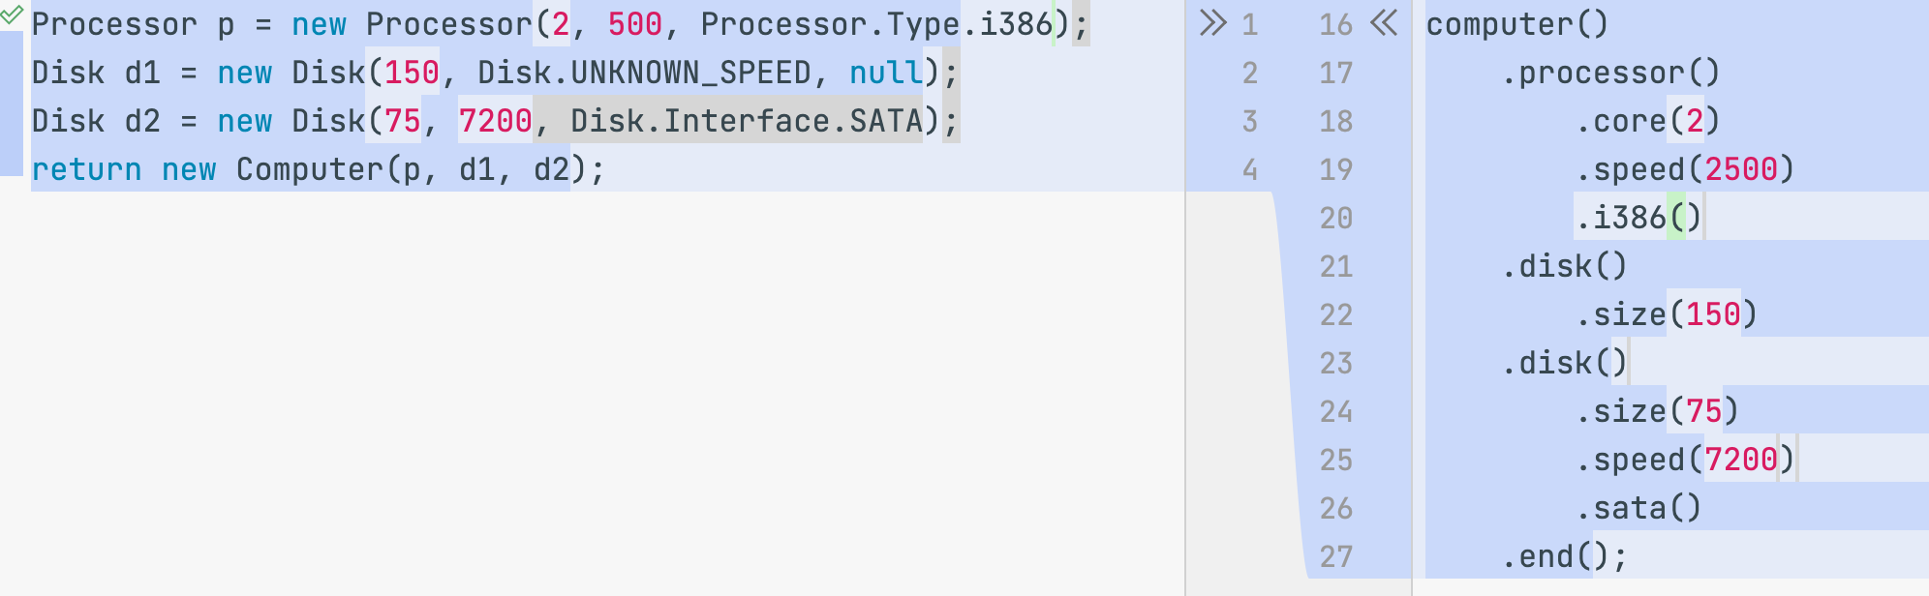
Method chaining pattern

Slide 13
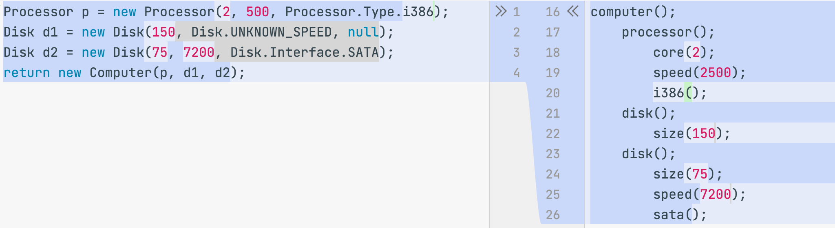
Function sequence pattern

Slide 14
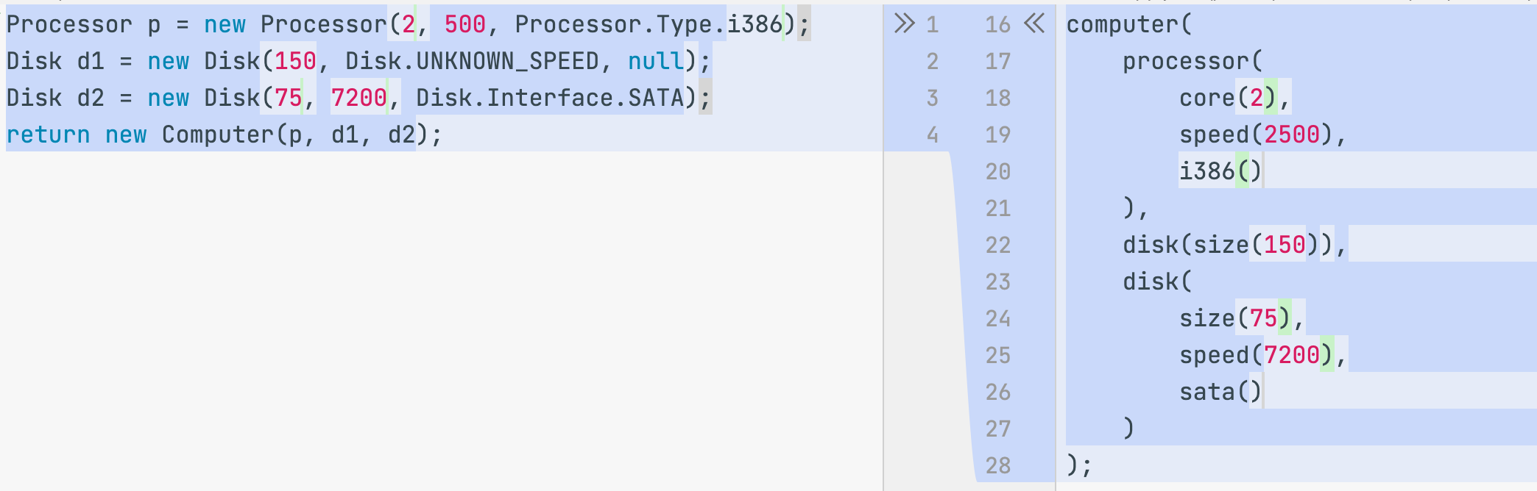
Nested function pattern

Slide 15
Method chaining pattern

Slide 16
Method chaining pattern
Advantages - Uses a sequence of method calls where each call acts on the result of the previous calls. - Allows you to easily compose multiple method calls without relying on a lot of variables, which gives you code that seems to flow, feeling more like its own language.
Disadvantages - When called a lot of methods, chain can be big. - It’s difficult to specify in the language that certain clauses must be present.

Slide 17
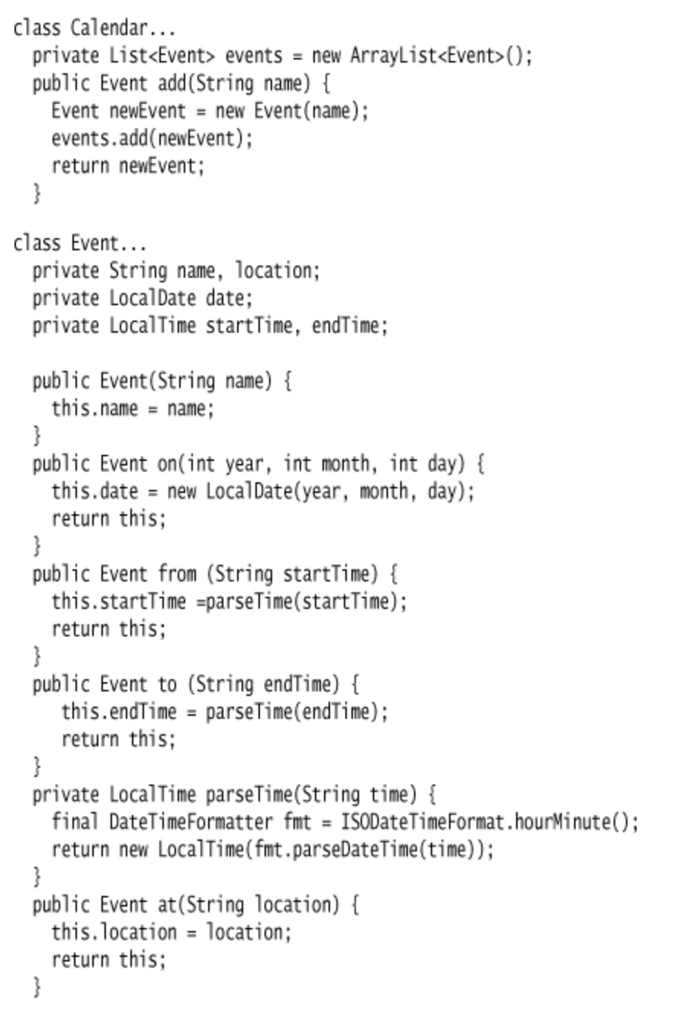
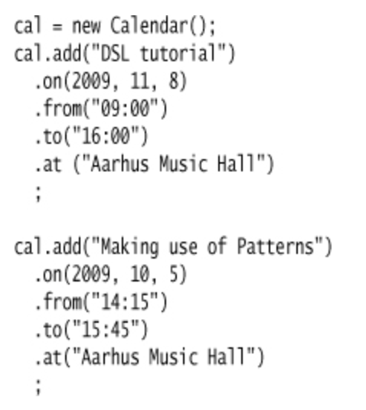
Fluent Calendar without builder

Slide 18
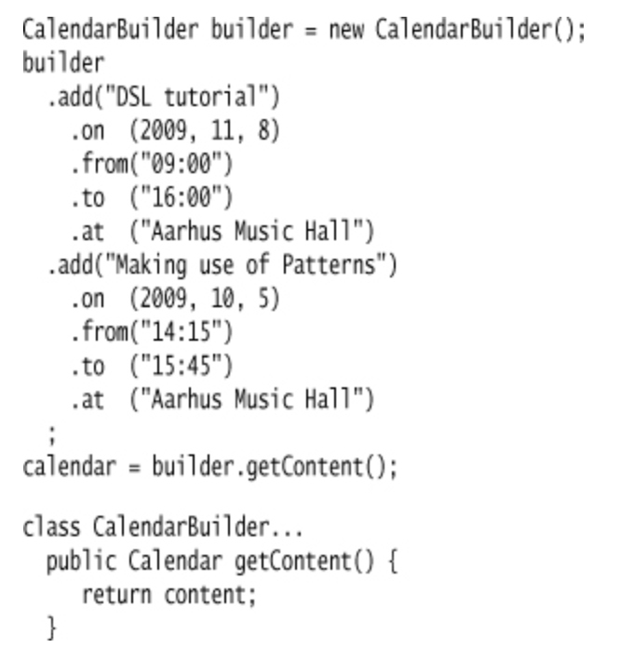
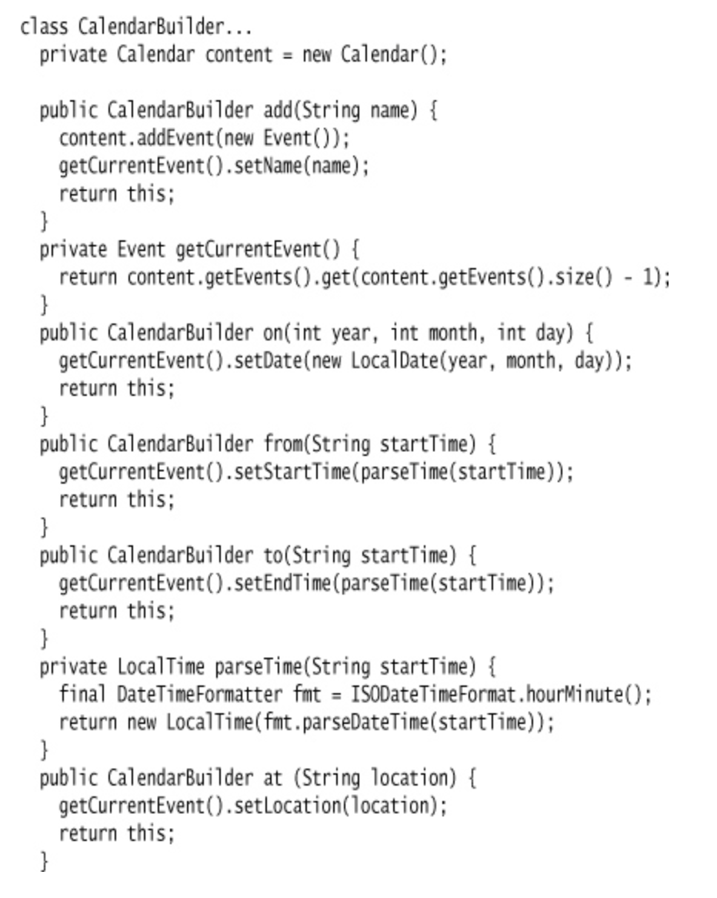
Fluent Calendar with Expression Builder

Slide 19
Add rules for chaining pattern

Slide 20
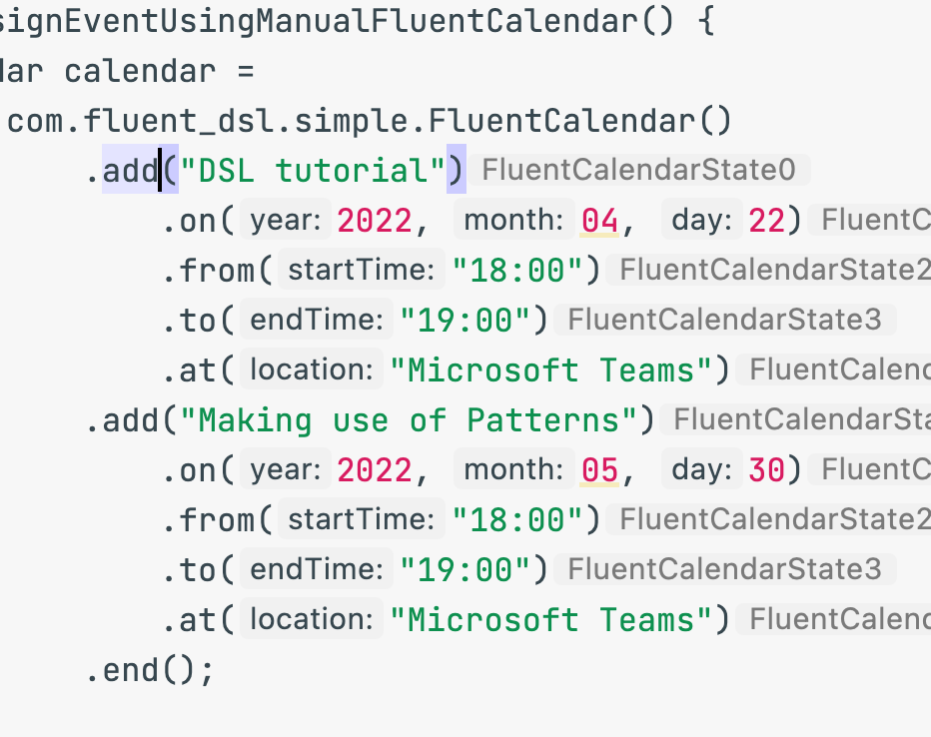
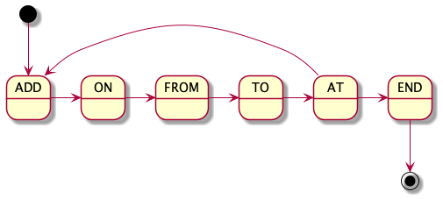
Create state machine for Fluent Calendar

Slide 21
How we can add rules to the logic
Using interfaces allows us add rules.
The implementation was first introduced about 5 years ago in the Microsoft Azure SDK.

Slide 22
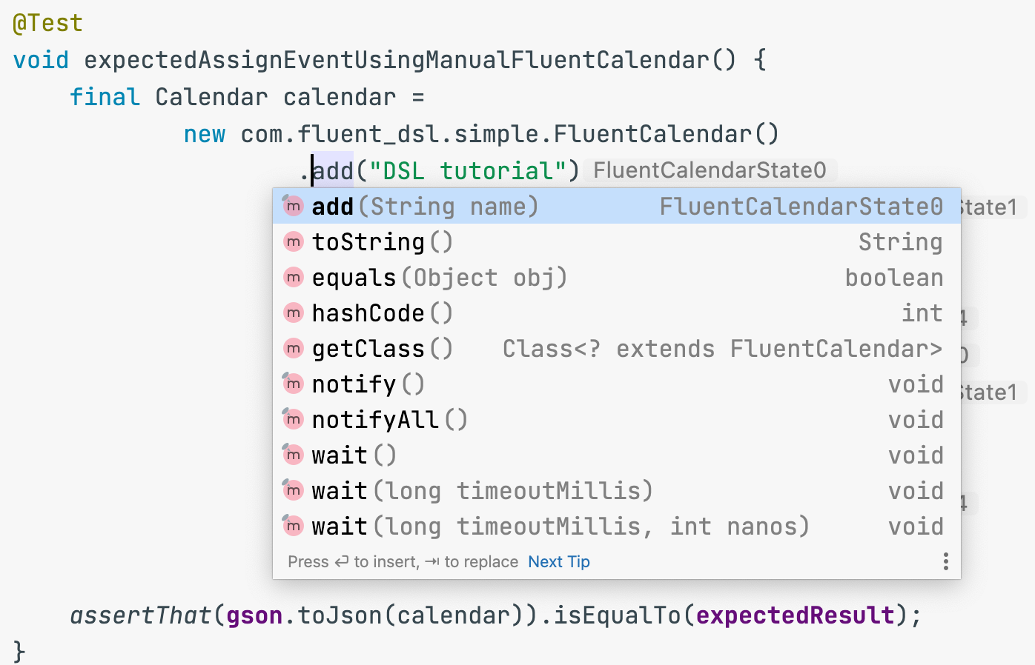

Slide 23
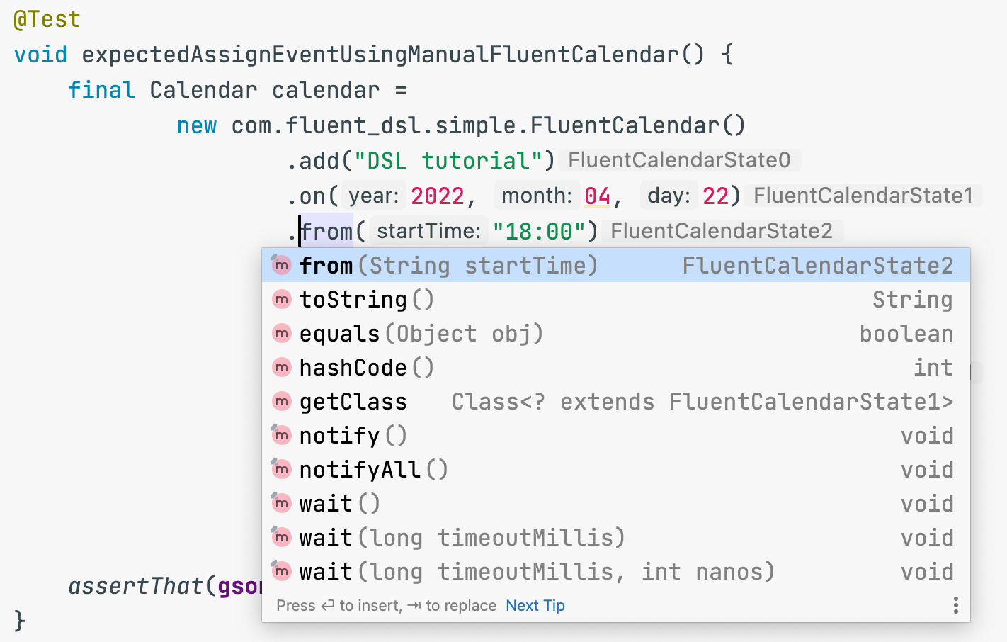

Slide 24
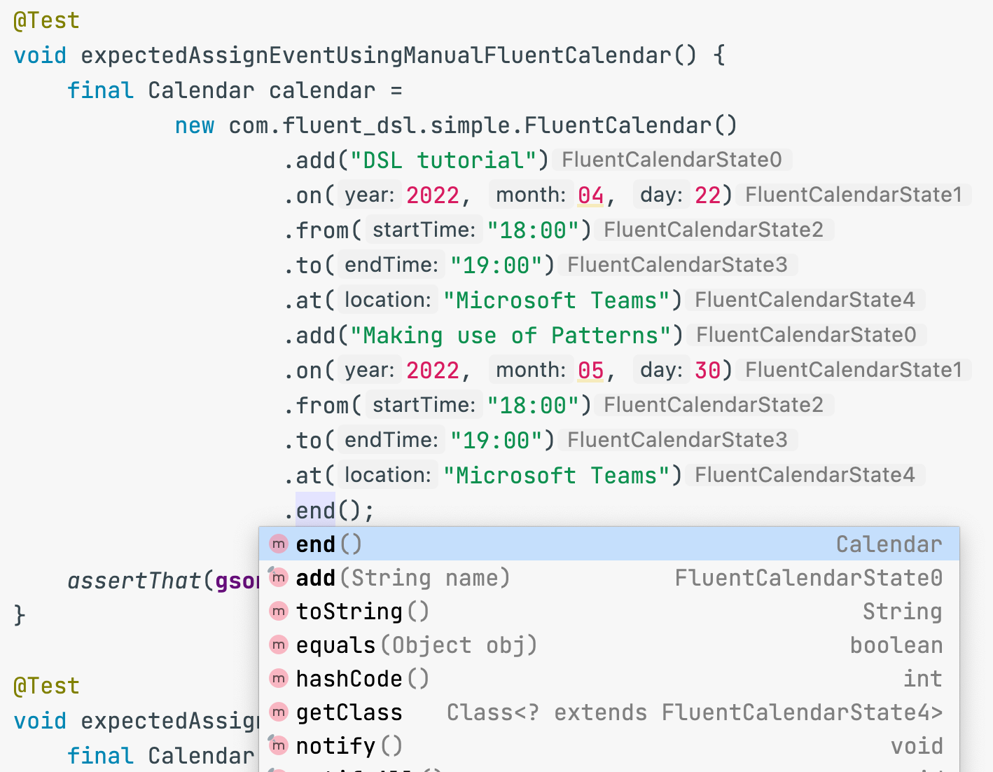

Slide 25
Frameworks to create Fluent Interface

Slide 26
How automate boilerplate and boring work.
Create DSL for creating DSLs.
The appropriate and already existing DSL for out goal are regular expressions.
The rules can be described on the basis of regular expressions.
The technical classes can be generated based on described rules.

Slide 27
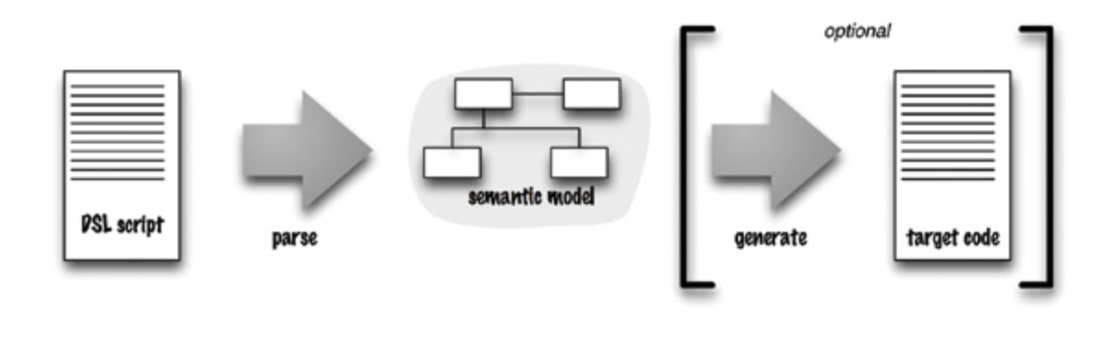
The architecture of DSL processing

Slide 28
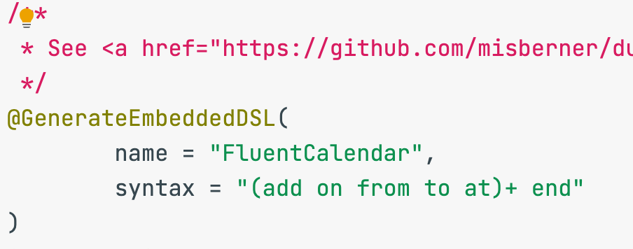
Calendar rules described based on RegEx

Slide 29
Existing frameworks in the world
Duzzt (An Annotation-based Embedded DSL Generator for Java)

Slide 30
Practical experience
Creating DSL for creating routes among services.

Slide 31
Interesting links
Domain-Specific Languages (Martin Fowler)
Meta Programming System (JetBrains MPS)
Fluent Interface (Martin Fowler)
Duzzt (Malte Isberner)

Slide 32
Questions?

Slide 33
Topics for further events

Slide 34
Topics for further events
ZeroMQ message library.
Java Code Generation.
Creating a Java Compiler Plugins.
Make grammatics based on (A)BNF, ANTLR.
Custom message bus (p2p).
Practical using Routing Slip pattern.
Java NIO, Server-Client example.
Troubleshooting off-memory leaks, linux cgroups.
Review of QUIC/HTTP3 protocol.

Slide 35
THANKS YOU!

